Slide 1
Smart Glasses for the Visually Impaired
Supervised By:
Dr. Ahmed Hamza (Lecturer at Faculty of Computer and Information Technology, Egyptian E-Learning University)
Eng. Mostafa Abdelbari (Teaching Assistant at Faculty of Computer and Information Technology, Egyptian E-Learning University)

Slide 2
Marwan Maher Mostafa said
Menna Allah Mahmoud Thabet
Hassan Abo Elghet
Nancy Saad Mohammed
Mahmoud Abd-Elghani Hassan Abd-Elghani
Nada Hamada Salah
Arwa Sayed elearosy mohamed

Slide 3
Table of contents
01
02
03
04
Problem Statement
Problem Solution
System Overview
Software Requirements

Slide 4
Table of contents
05
06
System Performance
System output
07
Main code

Slide 5

Introduction
In a world that is increasingly interconnected and driven by technological advancements, it becomes imperative that we ensure no one is left behind. According to the World Health Organization, at least 2.2 billion people have a near or distance vision impairment. In at least 1 billion of these, vision impairment could have been prevented or is yet to be addressed. The leading causes of vision impairment and blindness at a global level are refractive errors .

Slide 6


2,200,000,000
According to the World Health Organization, people have poor near or distance vision

Slide 7
01
Problem Statement

Slide 8
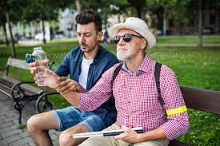
Problem Statement
Visually impaired individuals face persistent challenges in navigating their surroundings and accessing information, hindering their independence and inclusion in daily life. Traditional tools like white canes and guide dogs provide valuable assistance but fall short in delivering real-time and comprehensive solutions.

Slide 9

Key Challenges
Limited Real-time Information: Existing tools lack the capability to provide real-time information about the immediate environment, making navigation unpredictable.
Text Accessibility:
Printed text, from signs to documents, poses a significant barrier. The lack of efficient text-to-speech conversion limits access to critical information.

Slide 10
02
Problem Solution

Slide 11
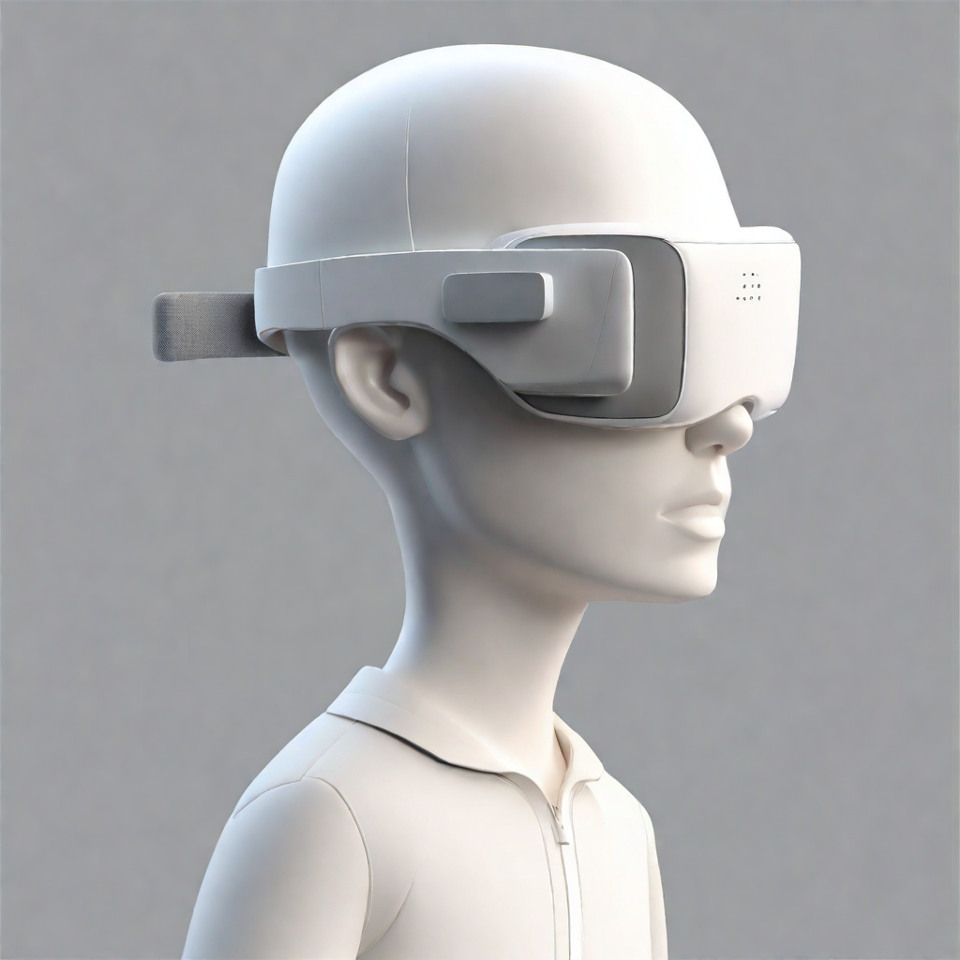
Smart Glasses Features:
1-Text-to-Speech Conversion:
Solution: Create a sophisticated text recognition and conversion system, enabling the Smart Glasses to read aloud printed text. This feature enhances access to information from signs, documents, and other written materials.

Slide 12
Our Vision:
In response to the challenges faced by visually impaired individuals, we propose the development of Smart Glasses integrated with innovative software. Our vision is to create a comprehensive solution that empowers the visually impaired community, providing them with unprecedented independence and access to information.

Slide 13
03
System Overview

Slide 14
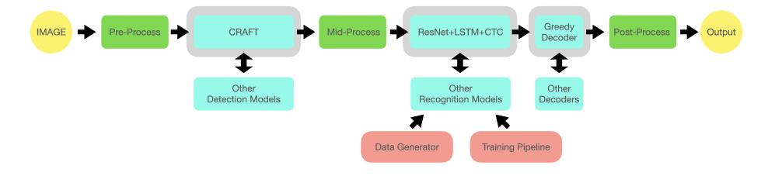
System methodology

Slide 15
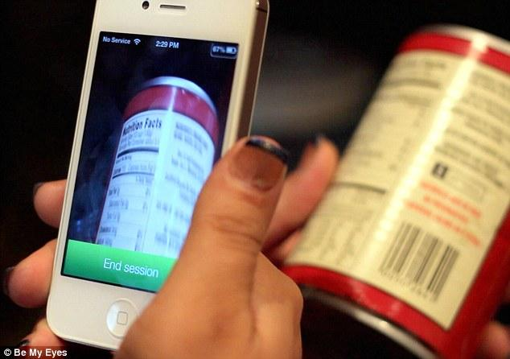
Key Features:
1.1 Text Recognition
1.2 Speech Synthesis
1.3 Real-time Feedback

Slide 16
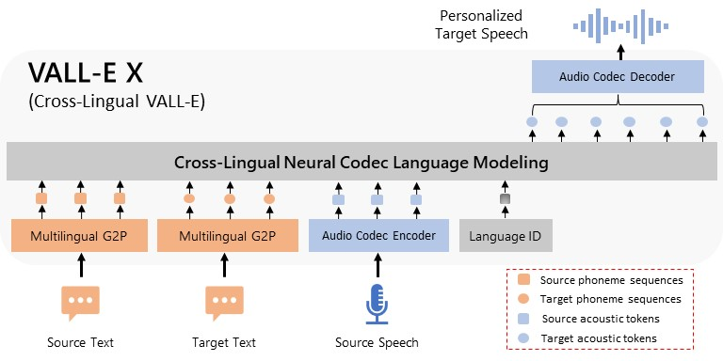
Speech model

Slide 17
Speech model
Key Components:
Multilingual G2P (Grapheme-to-Phoneme) Conversion:
Converts both source and target text into phoneme sequences.
Audio Codec Encoder:
Encodes source speech into acoustic tokens.
Language ID:
Identifies the language of the input data.
Cross-Lingual Neural Codec Language Modeling:
Combines phoneme sequences and acoustic tokens to generate a cross-lingual representation.
Audio Codec Decoder:
Decodes the combined representation into personalized target speech.

Slide 18
Speech model
Process Flow:
Source Text: Converted into phoneme sequences using Multilingual G2P.
Target Text: Similarly converted into phoneme sequences.
Source Speech: Encoded into acoustic tokens by the Audio Codec Encoder.
Language ID: Identifies the language to ensure correct processing.
Cross-Lingual Modeling: Integrates all components to create a unified cross-lingual representation.
Output: The Audio Codec Decoder produces personalized target speech from the combined data.

Slide 19
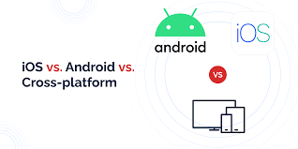
App development
Django API
The backend of the application is powered by a Django framework, which handles the server-side logic, including API requests, model inference, and data management.
Vue.js Framework
The frontend application is built using the Vue.js framework, known for its flexibility and ease of integration. Vue.js allows for the creation of a responsive and accessible user interface.
IonicThe mobile application is developed using the Ionic framework, enabling cross-platform functionality and a native-like experience for both iOS and Android users.

Slide 20
04
Software Requirements

Slide 21



lmdb
pillow
torchvision

Slide 22


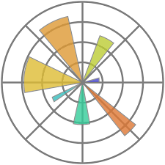
nltk
ubuntu
matplotlib

Slide 23


numpy
opencv-python-headless

Slide 24
05
System Performance

Slide 25
Our experiment
Model | Year | Train data | IIIT 3000 | SVT 647 | IC03 867 | IC13 1015 | IC15 2077 | SP 645 | CT 288 | Time ms/image
CRNN | 2015 | MJ+ST | 82.9 | 81.6 | 92.6 | 89.2 | 64.2 | 70.0 | 65.5 | 8.3
RARE | 2016 | MJ+ST | 86.2 | 85.8 | 93.7 | 91.1 | 68.9 | 76.2 | 70.4 | 10.8
R2AM | 2016 | MJ+ST | 83.4 | 82.4 | 92.0 | 88.1 | 63.6 | 72.1 | 64.9 | 2.9
STAR-Net | 2016 | MJ+ST | 87.0 | 86.9 | 94.0 | 91.5 | 70.3 | 77.5 | 71.7 | 48.7
GRCNN | 2017 | MJ+ST | 84.2 | 83.7 | 93.0 | 88.8 | 65.8 | 73.6 | 68.1 | 4.6

Slide 26
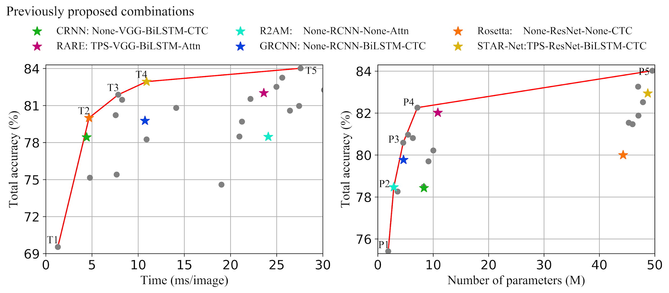

Slide 27
06
System output

Slide 28
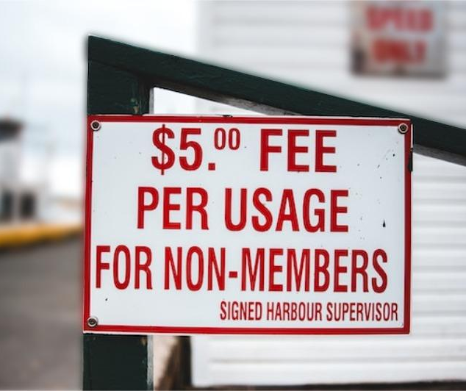
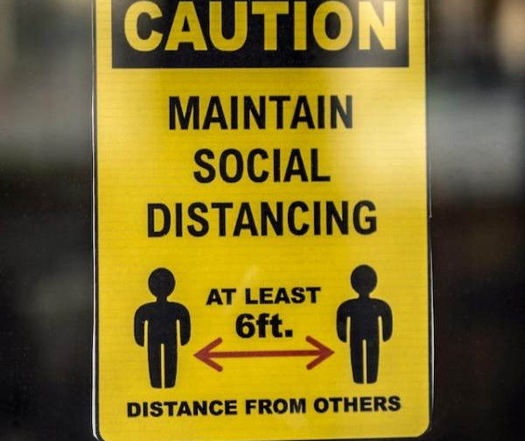
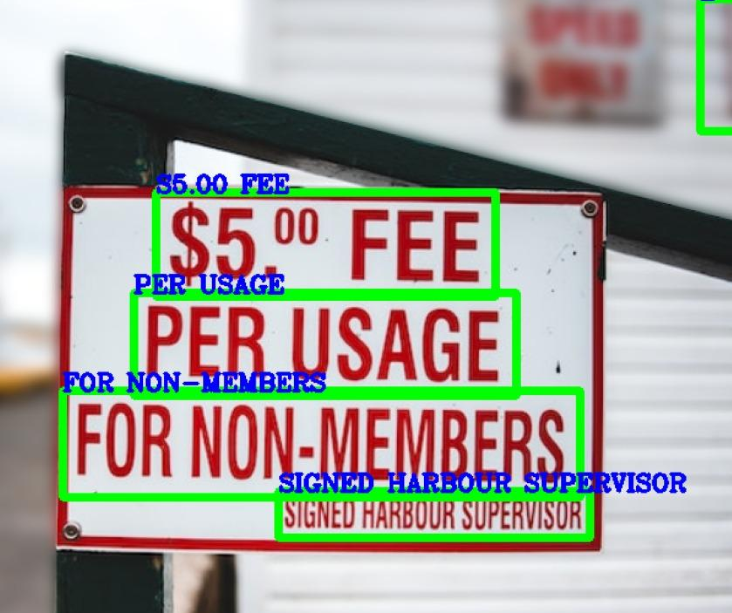
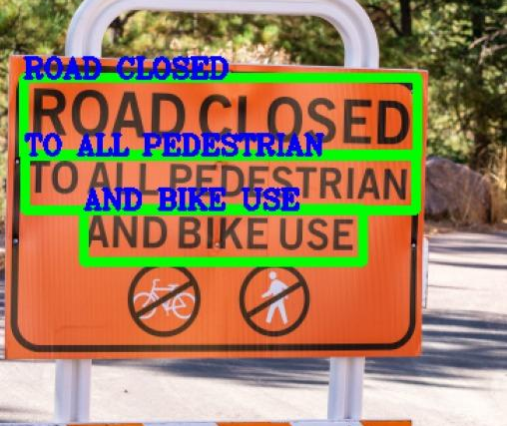
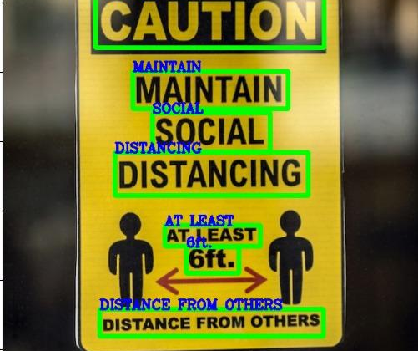
Outputs

Slide 29
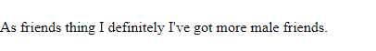

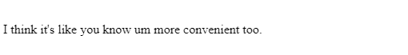
Outputs

Slide 30
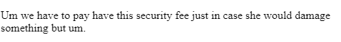
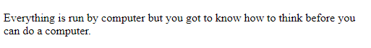
Outputs

Slide 31
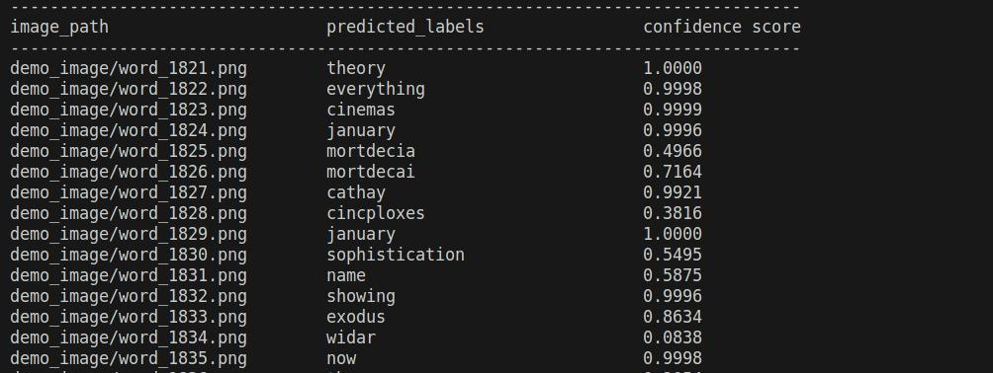
Model output

Slide 32
07
Main code

Slide 33
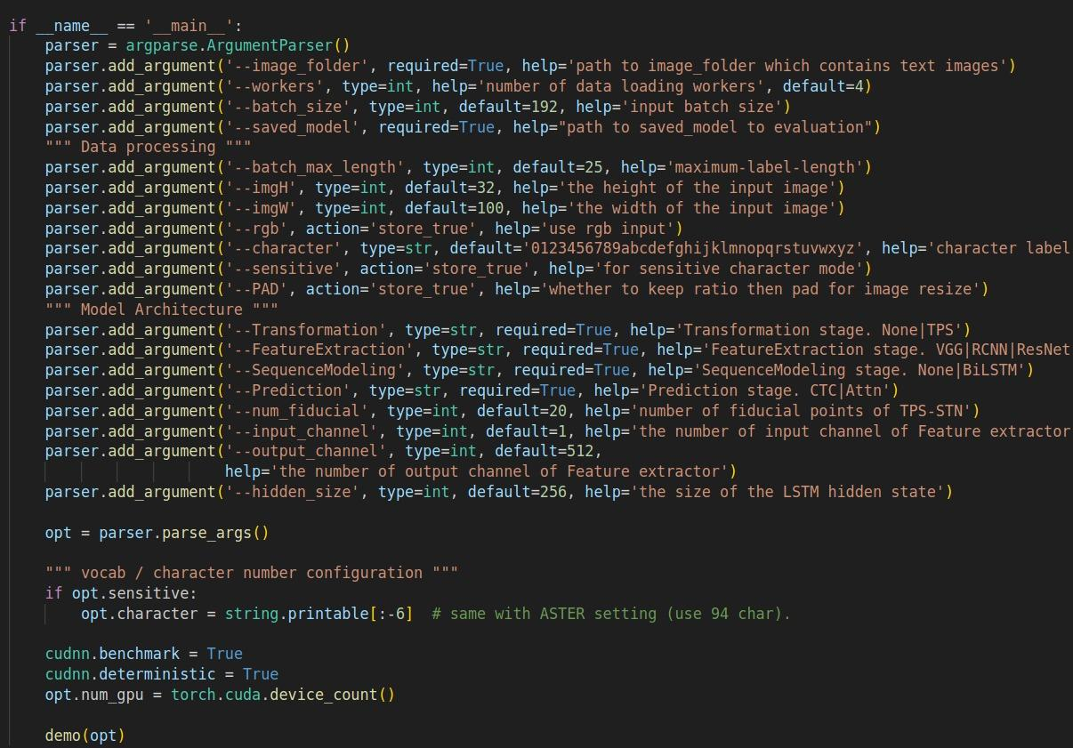
deep learning model

Slide 34
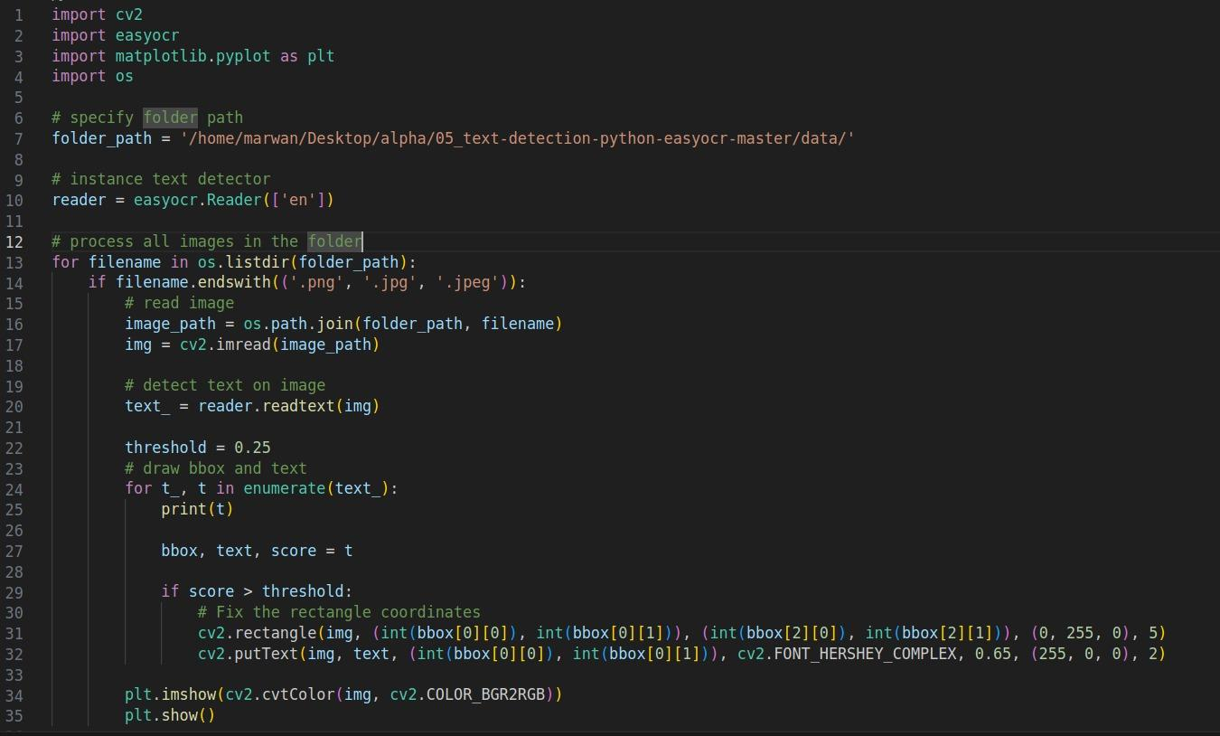

Slide 35
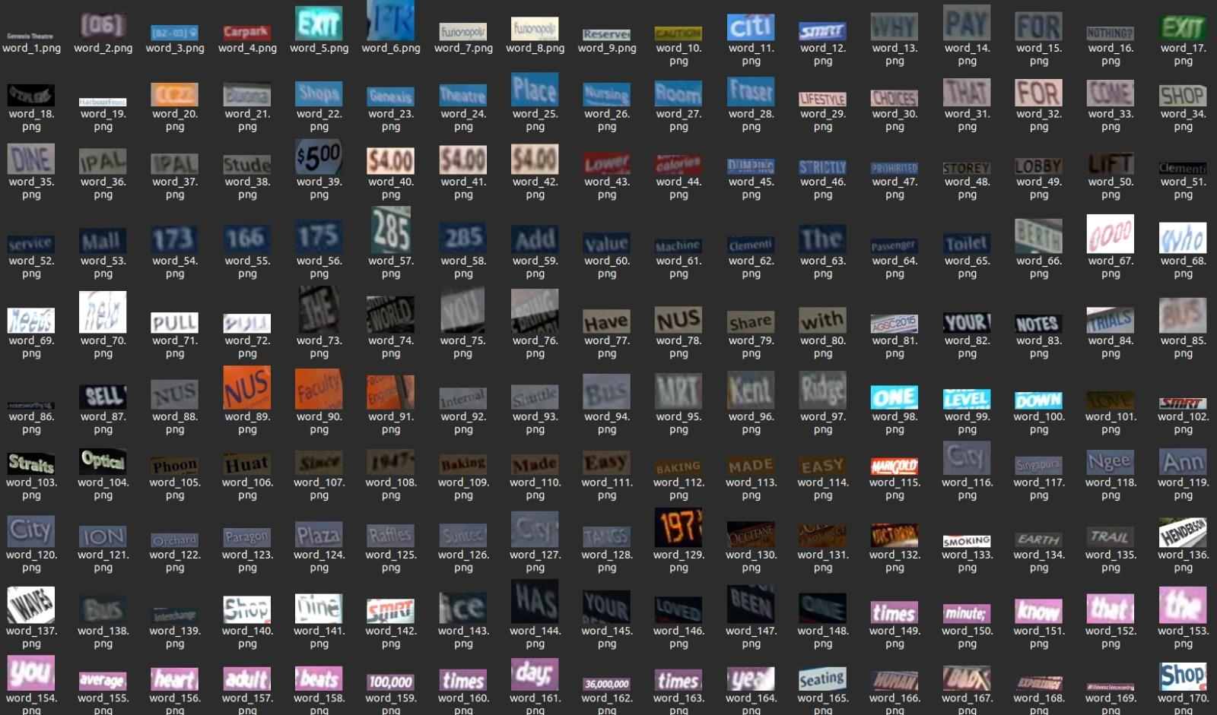
Dataset simple

Slide 36
Reference
https://arxiv.org/abs/1904.01906
https://www.dropbox.com/sh/j3xmli4di1zuv3s/AAArdcPgz7UFxIHUuKNOeKv_a?e=1&dl=0
https://www.who.int/publications/m/item/increasing-eye-care-interventions-to-address-vision-impairment#:~:text=Globally%2C%20at%20least%202.2%20billion,%2Dincome%20countries%20(LMICs).
https://ui.adsabs.harvard.edu/abs/2018AAS...23222309K/abstract
https://www.xenonstack.com/insights/crnn-for-text-recognition

Slide 37
Thanks!
Do you have any questions?

